Slide 1
EARLY EMPIRES AND FEUDALISM

Slide 2
Introduction
The world economy we see today is the outcome of major changes in how the world have been organized economically and divided geographically. Down until the 1500s CE much of the world was organized into empires that waxed and waned. In Western Europe the Roman Empire gave way to a very localized type of economy labeled “feudalism” which was what provided the backdrop to the beginnings of the merchant capitalism and later the industrial capitalism (based in private ownership and accumulation of capital) that in expanding worldwide gave rise to the world economy.
The purpose today: 1. lay out some simple geographical models of how the world has been and could be organized and how these have evolved over time; 2. describe some of the early empires and how they worked to redistribute resources from their edges to their centers; 3. discuss how Western Europe took a peculiar course from empire to capitalism by way of feudalism; 4. point out that this was not inevitable because other empires (such as the Ottoman) could have replaced it; and 5. that the coming of the world economy in the 1500s was not just about the spread of capitalism but also of attempts at turning the world economy into world empires by the British, Dutch, and others. In the end, these attempts were only partial. Territorial autarky was always defeated by the desire to accumulate capital wherever that might be.

Slide 3
THEMES
Territories and networks
Empires and redistribution (Roman , Arab and Chinese Empires)
Imperial collapse and feudalism (European case)
The Ottoman challenge
Modern European empires and commerce vs. territorial autarky

Slide 4
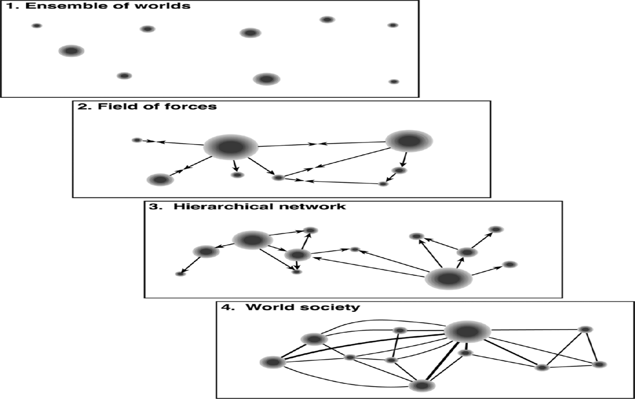
1. Territories and Networks

Slide 5
There are four basic models. The first one is of “power centers/empires” scattered widely without interaction as with the ancient empires. The second is basically the model of empires and states that emerged in Western Europe beginning in the 1500s. The third is the model of world cities and capital-trade flows that has emerged into prominence alongside the second but is now displacing it under contemporary globalization. The fourth is the idea of a more equal world as opposed to the unequal and hierarchical ones portrayed in the second and third models. The historic shifts in these models is provided in the next figure.

Slide 6
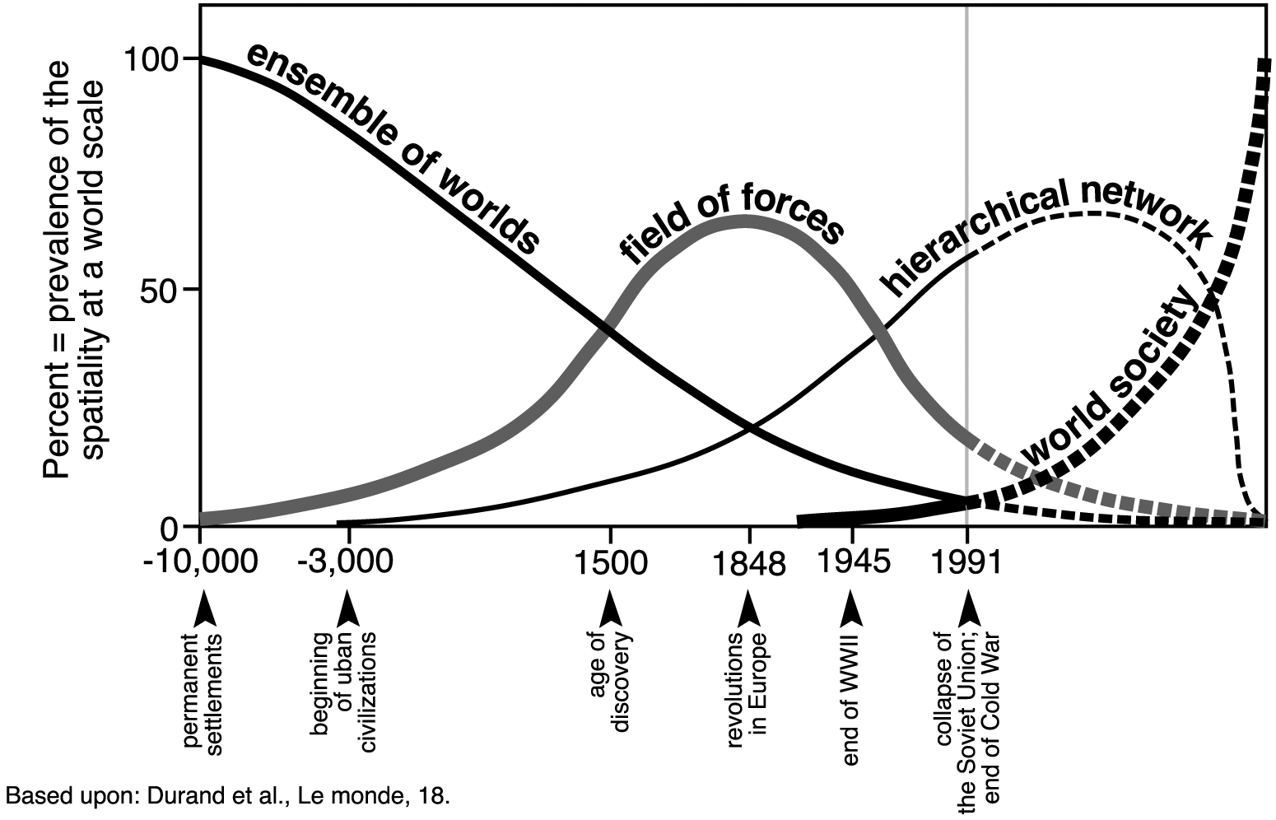
Figure 2: Territory versus Network Models over Time

Slide 7
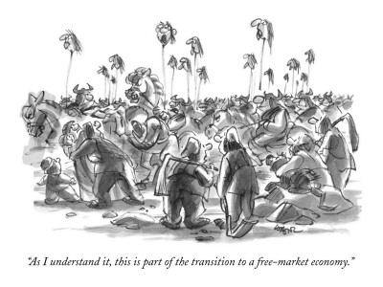
Resist thinking of any of these shifts or the ones discussed later as utterly predictable or inevitable

Slide 8
2. Empires and Periphery-to-Center Redistribution
Empires such as the Roman, Arab, and Chinese were based on subordination of large territories by a center and the systematic redistribution of resources and wealth from the peripheries to the centers (Figures 4-7). In the empires and around their outer edges there was trade that was based on either tribute or on market exchange (trade based on prices and the use of money)

Slide 9
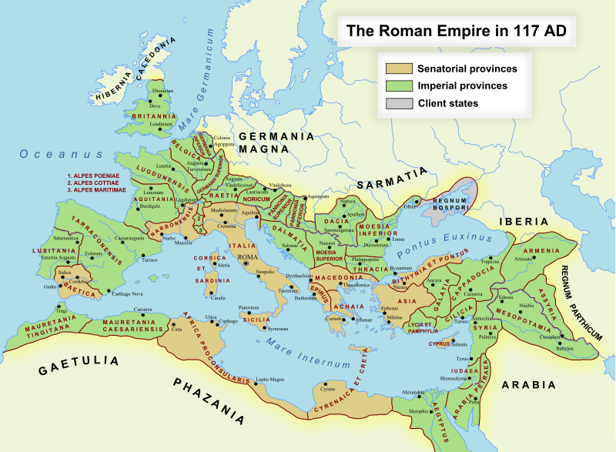
Figure 4: The Roman Empire at its maximum extent

Slide 10
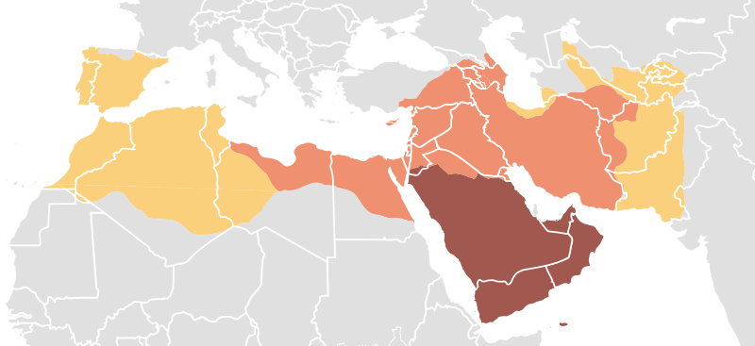
Figure 5: The Arab Empire (800 CE)

Slide 11
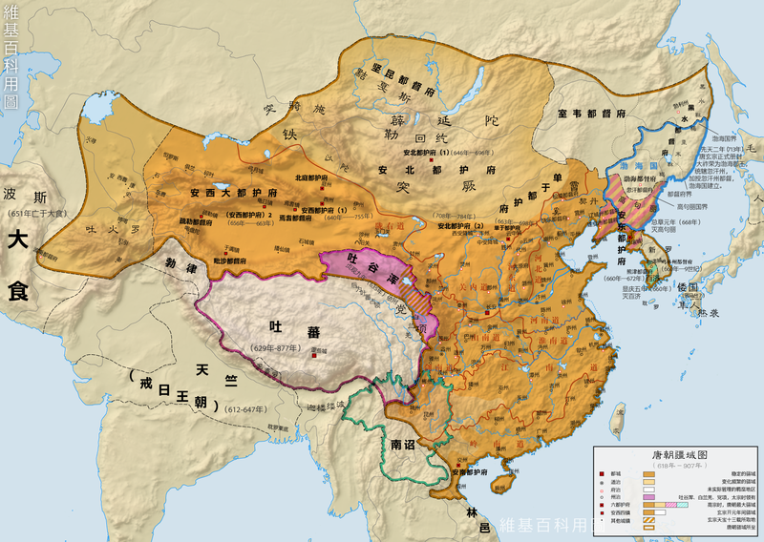
Figure 6: The limits of the Chinese Empire at its height (900 CE)

Slide 12
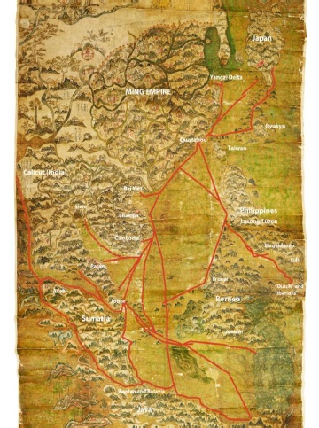
Figure 7: China’s trade links in East and SE Asia during the Ming Dynasty

Slide 13
3.Imperial Collapse and Feudalism in Western Europe
After the collapse of the Roman Empire in Western Europe (4th-5th century CE) there was an unraveling of the trading linkages that knitted the empire together. In its place was a very localized form of economic organization in which long-distance trade retreated and political authority was vested in the hands of warlords and “nobles” (Figures 8 and 9). In the 11th and 12th centuries CE partly as an outgrowth of connections with the Arab World, trade began to revive in the Mediterranean (Figure 10). As a result cities in and around the Mediterranean began to develop based on trade and financing that trade (e.g. Florence and Venice).

Slide 14
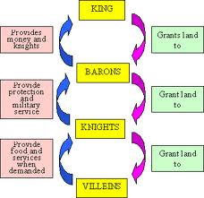
Figure 8: The feudal hierarchy

Slide 15
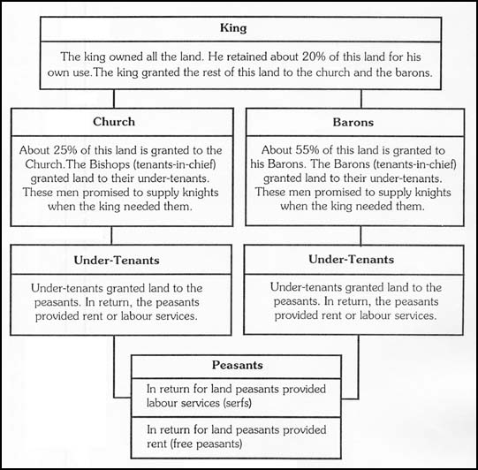
Figure 9: The social order of European feudalism

Slide 16
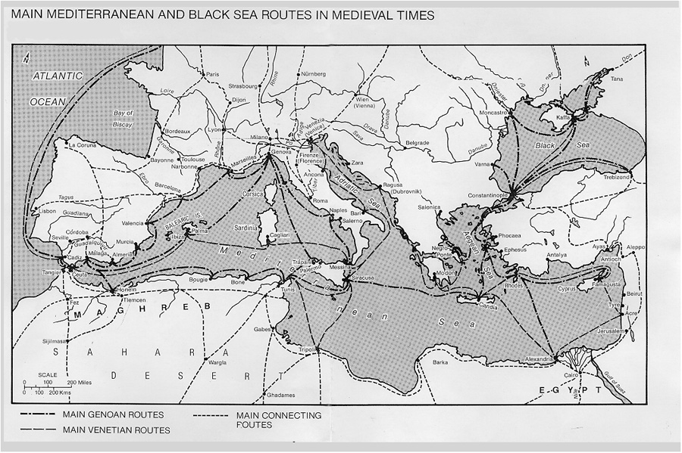
Figure 10: The medieval Mediterranean World

Slide 17
4. The Ottoman Challenge
The Ottoman Empire was at first a threat to this but by the 1600s has begun also to enjoy the fruits of trade (Figure 11). Very slowly the Ottoman Empire declined at much the same time the modern world economy was emerging in Western Europe (Figure 12).

Slide 18
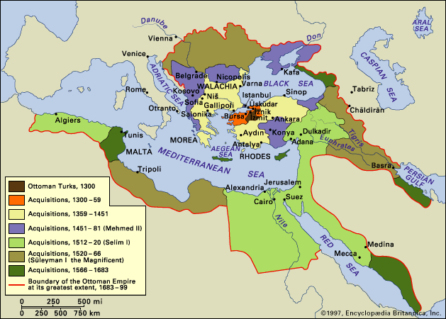
Figure 11: The creation of the Ottoman Empire

Slide 19
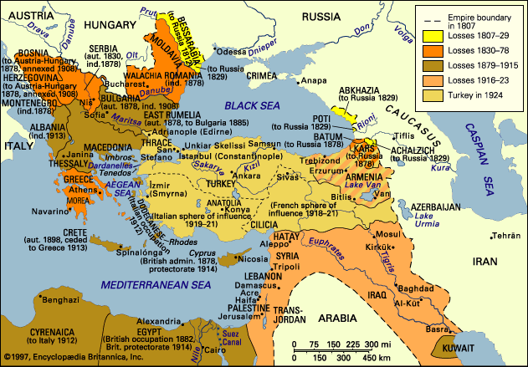
Figure 12: The breakup of the Ottoman Empire

Slide 20
5. Modern European Empires versus Territorial Autarky
The various European colonial empires that grew from the 1500s onwards always could have turned away from the trend towards a mix of the field-of-forces and hierarchical network models to a singular version of the first one. Rather, what happened was that direct imperial control was increasingly replaced by an imperialism based on control over investment and trade and not territory. The so-called triangular trade in the Atlantic Ocean was of this nature involving the development of capitalist agriculture in the Americas through the capture and shipment of slaves and the export of manufactures from Europe in return for the raw materials produced in the colonies (Figure 13). Initially this “imperialism” was managed by imperial governments but by the late 1700s the trend was towards businesses and individual investors being the primary actors (Figure 14). In the case of British business, for example, by the mid-1800s Latin America, even though 98% was not within the British Empire, was the most important destination fro British-origin investment overseas (Figure 15).
So, to conclude, 1. Modern empires turned into something very different from ancient ones; 2. Increasingly trade and investment were not funneled through empires; and 3. Based in the disintegration of feudalism and seeing off the challenge from the Ottoman Empire, Western Europe had “ripened” itself to become the center of an explosive capitalist world economy. That is the next topic: Europe and Merchant capitalism.

Slide 21
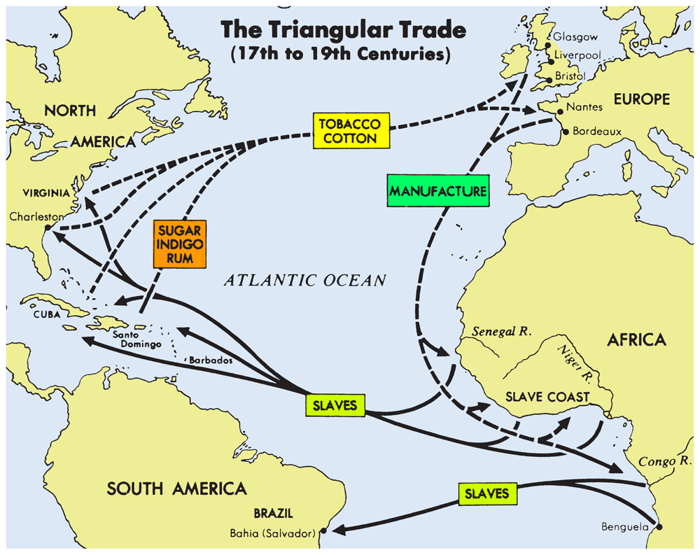
Figure 13: When is imperialism not just imperial?

Slide 22
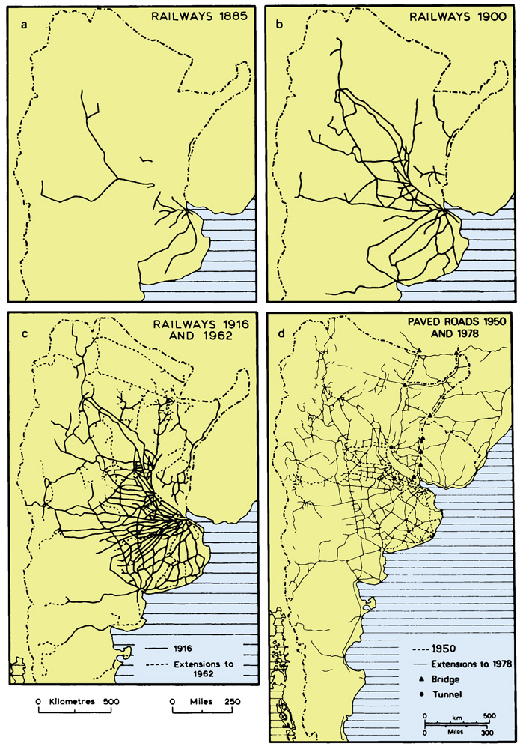
Figure 14: Roads and railways in the River Plate region largely financed by British businesses

Slide 23
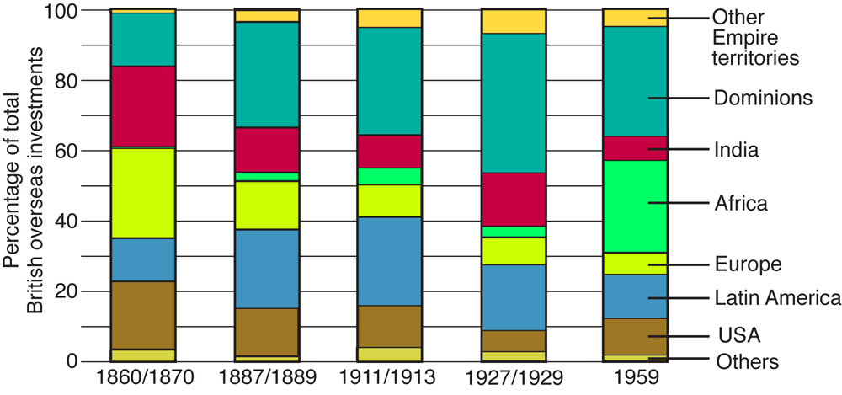
Figure 15: British FDI 1860-1959

Slide 24
